Slide 1
John Lee Summer Project
Probability Based Surgical planning tool for balloon angioplasty

Slide 2
Data Gathering

Slide 3
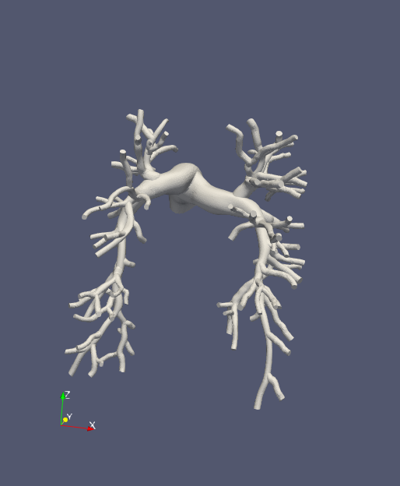
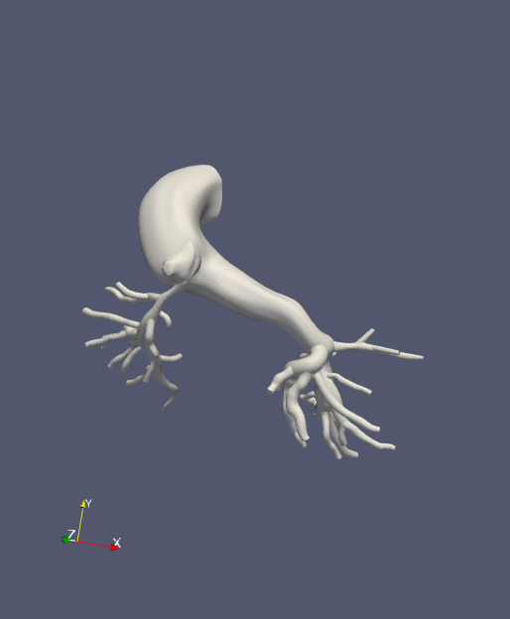
Models
Healthy Models
Artificially stenose models
Helpful to know actual healthy values for uncertainty quantification later
Stenosis Models
Have actual stenosis which must be identified
Should have previously computed RCR boundary conditions
0080_0001 (Healthy)
0118_1000 (Alagille)
Notes:
Model Issues
- Some models are not finely meshed/blended well and have issues constructing centerlines
- Ingrid’s models are in an older version of simvascular and must be reconstructed.

Slide 4
Issues with Models
Some Models are not finely meshed enough to construct centerlines (Major issue, resolvable by reconstructing finer models)
'0005_1001', '0119_0001', '0081_0001', '0084_0001’]
SU0267, SU0269
We will move ahead with 1 model from Healthy (0080_0001), and 2 Models from Stenosis (0118_1000, SU0238)

Slide 5
Healthy Models – BC tuning

Slide 6
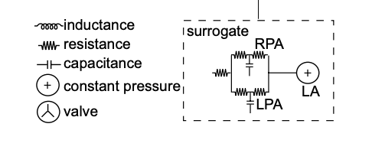
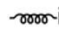
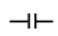
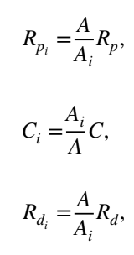
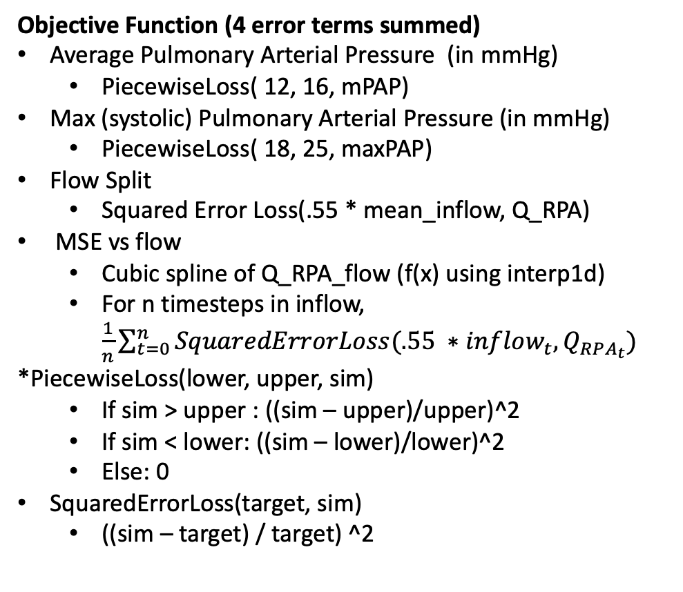
Healthy Models/ BC tuning
Objective Function (4 error terms summed)
Average Pulmonary Arterial Pressure (in mmHg)
PiecewiseLoss( 12, 16, mPAP)
Max (systolic) Pulmonary Arterial Pressure (in mmHg)
PiecewiseLoss( 18, 25, maxPAP)
Flow Split
Squared Error Loss(.55 * mean_inflow, Q_RPA)
MSE vs flow
Cubic spline of Q_RPA_flow (f(x) using interp1d)
For n timesteps in inflow, $\frac{1}{n}\sum_{t=0}^{n}{SquaredErrorLoss(.55 ∗inflow_{t}, Q_{RPA_{t}})}$
*PiecewiseLoss(lower, upper, sim)
If sim > upper : ((sim – upper)/upper)^2
If sim < lower: ((sim – lower)/lower)^2
Else: 0
SquaredErrorLoss(target, sim)
((sim – target) / target) ^2
Yang et. al. 2019 Surrogate model (Modified)
MPA
Constant RCL values for MPA
C is computing assuming linear eh_r of 1.2e6 dynes/cm^2
RPA Tree and LPA Tree precomputed resistances
Tunable RCR boundary conditions for LPA and RPA, with constant capillary wedge pressure of 7 mmHg
Split RCRS (Yang et. al. 2019)
Optimization
Ideal: obj func < .001 (.1% error)
Typically set lower and let it early stop.
Early stop: patience (5 iter), patience_tolerance (1e-6)

Slide 7
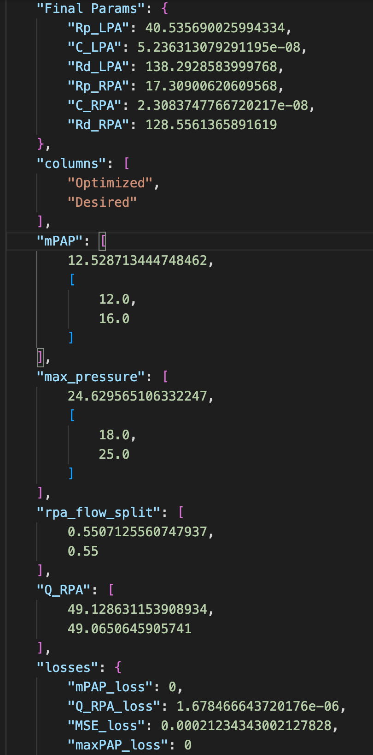
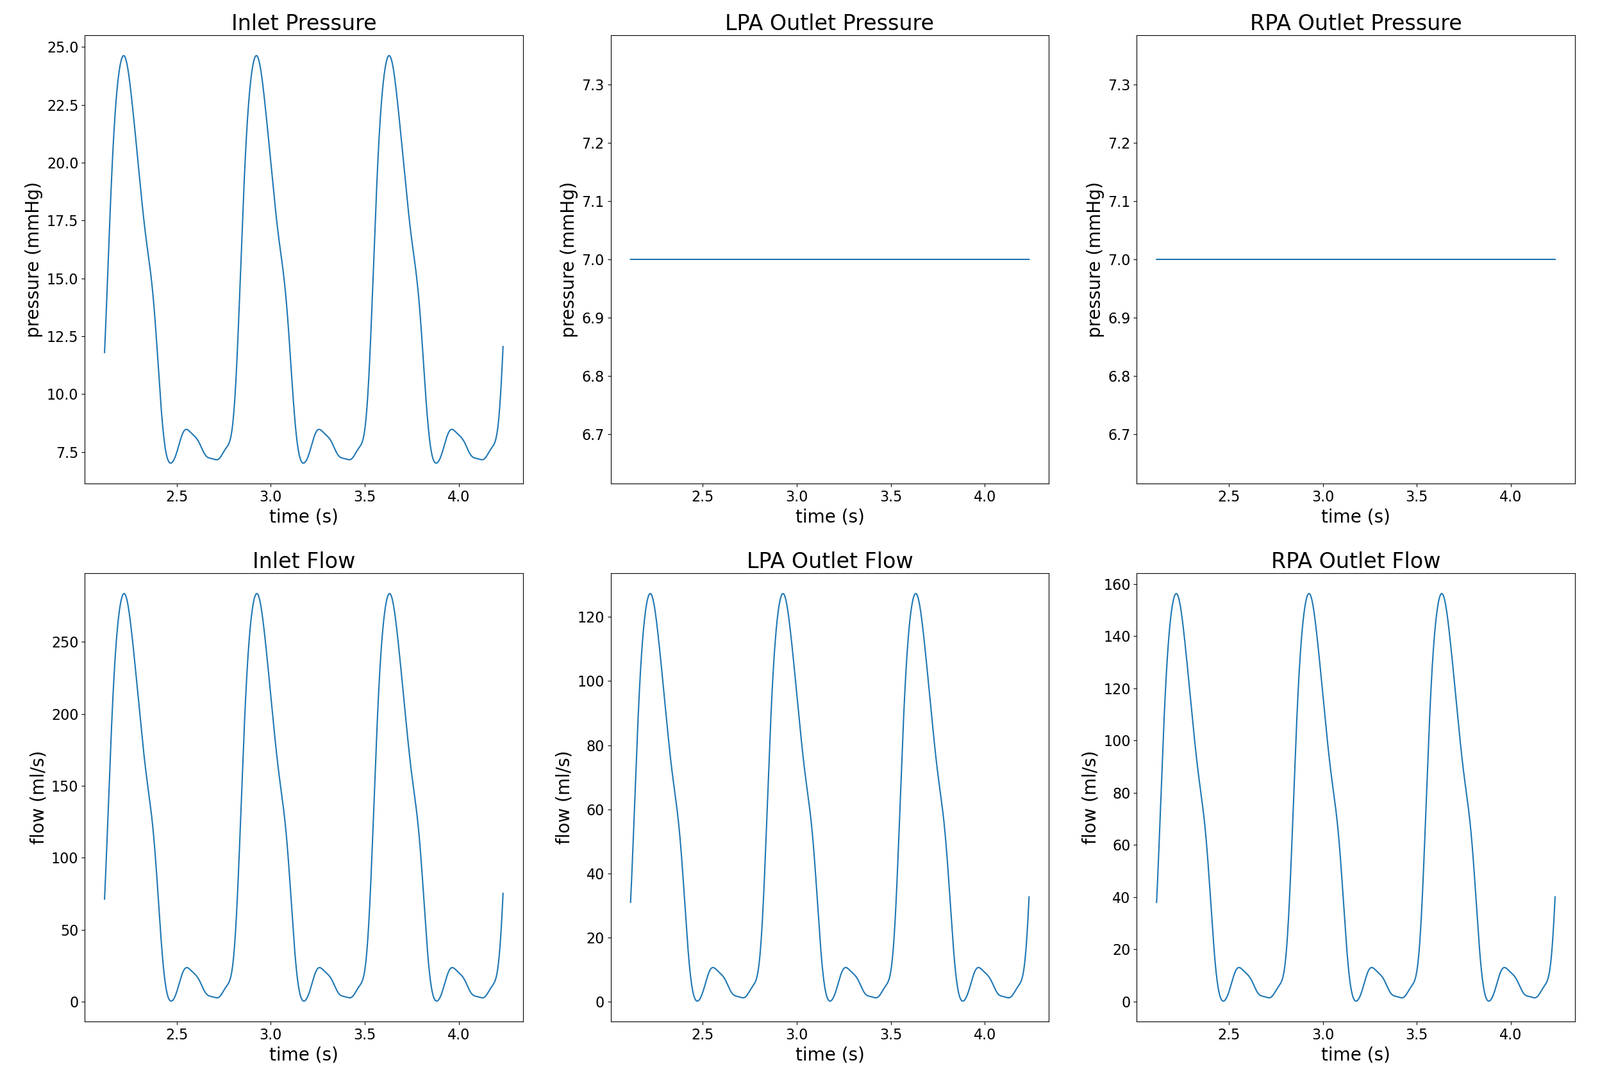
Optimization Results/Sanity Checks (ex. 0080_0001)

Slide 8
Issues w/
Lumped Multiple Objective optimization is slightly inaccurate (acceptable error)
Capacitance of MPA is computed using a default EH_R value (not a significant influence)
Resistance of RPA and LPA trees are a rough estimate from the automatic construction of the vessel tree
We do not know if the RPA and LPA resistances appropriately correspond to the pressure drop across the tree.
e.g. R_LPA = 5 cgs, R_RPA = 4 cgs -> ~.16 mPAP drop across the tree
Should the Capillary Wedge pressure of 7 be the target after the BCs or after the tree itself?

Slide 9
Healthy Models - Artificial Stenosis

Slide 10
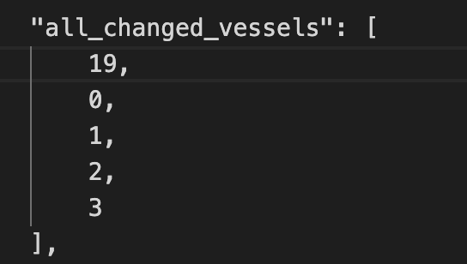
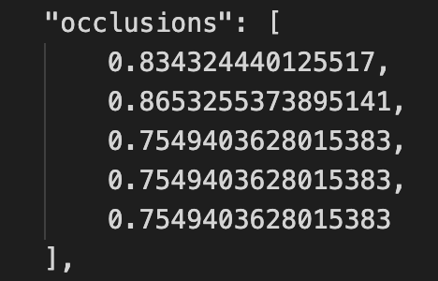
Methodology
Construct a Branch Tree of the PA w/ generations
Gen 0: MPA, Gen 1: RPA & LPA, …
Using the Branch tree, determine n possible branches to stenose in the first g generations
Use a y = poisson(𝜆 = 2*g) to determine how many locations exactly to stenose (this is subject to change)
Uniformly select y vessels from all n locations and give it an occlusion value from .75 - .9.
Make changes to R, C, L corresponding to occlusion change in the
Sample Stenosis only stenoses MPA (0), LPA (1,2,3), RPA (19).

Slide 11
Healthy Models - Case Study 0080_0001

Slide 12
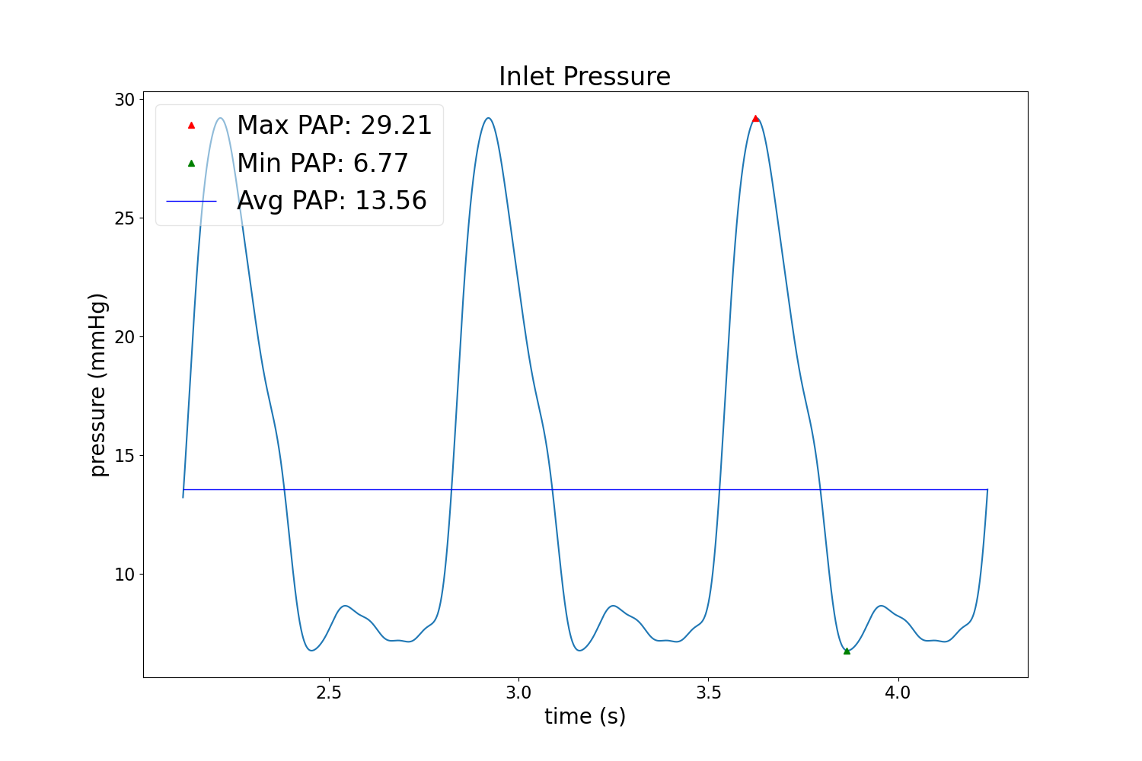
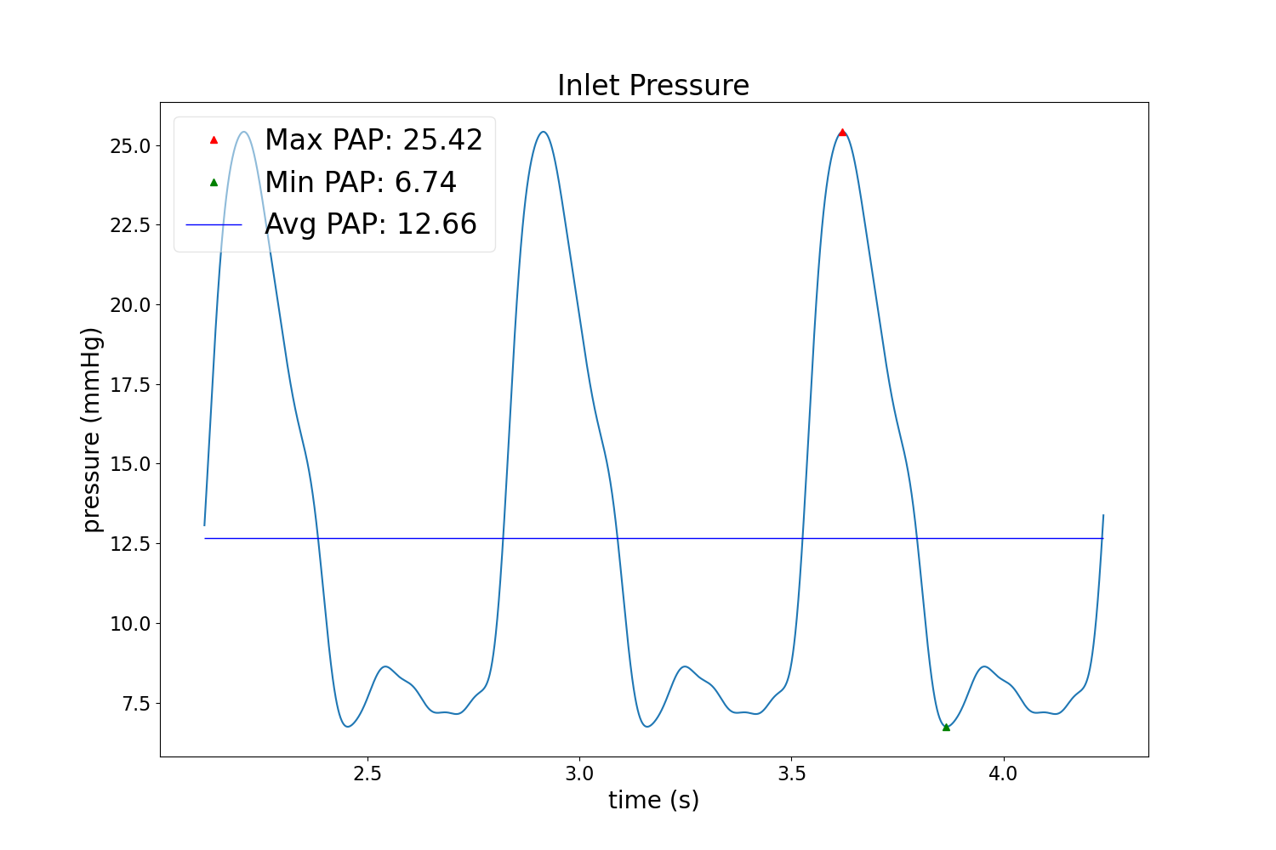
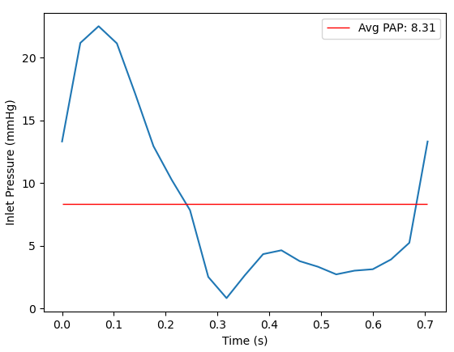
0D vs. 3D (Waveforms)
Method 1 (stenosis coeff)
Base Solver
M1 Solver
Notes:
mPAP drops to 1 in 3D solver?
3D solver uses different boundary conditions (does not consider rcr bcs)
3D Solver

Slide 13
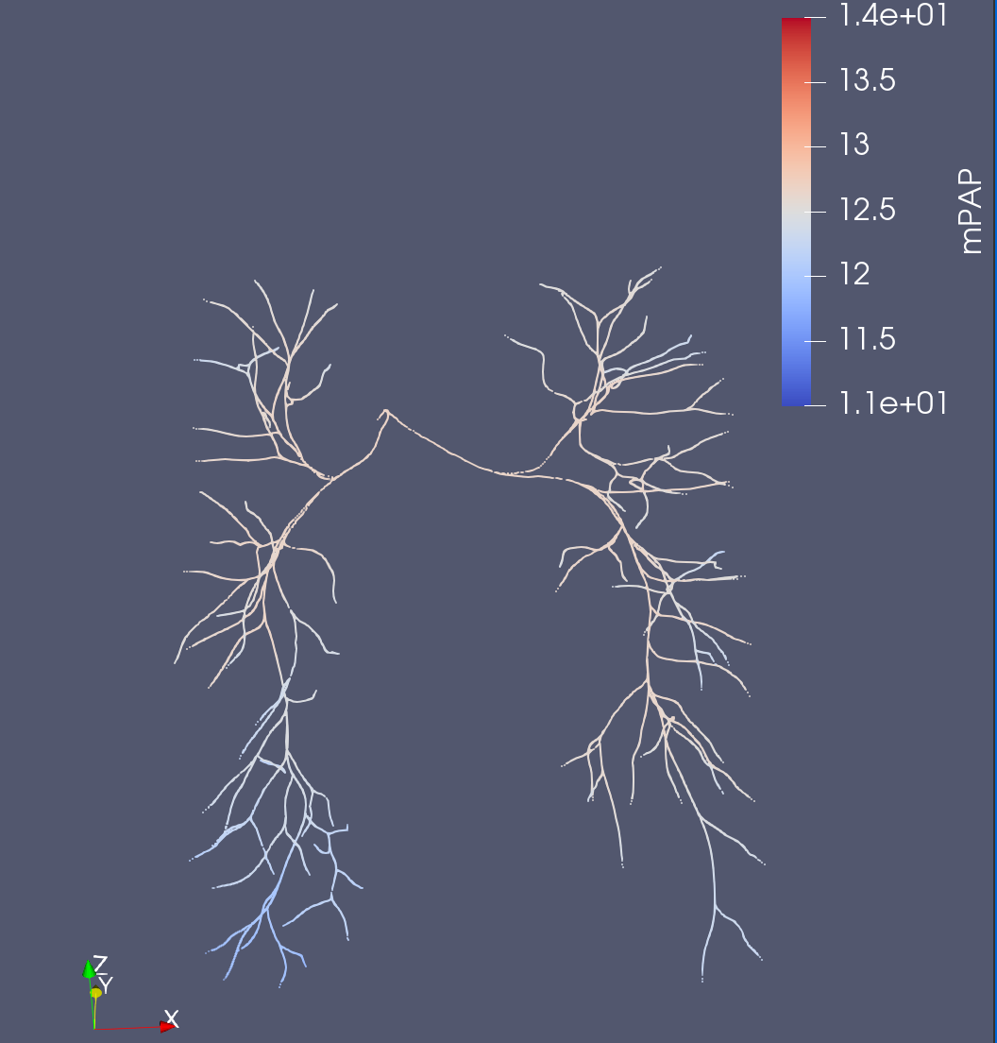
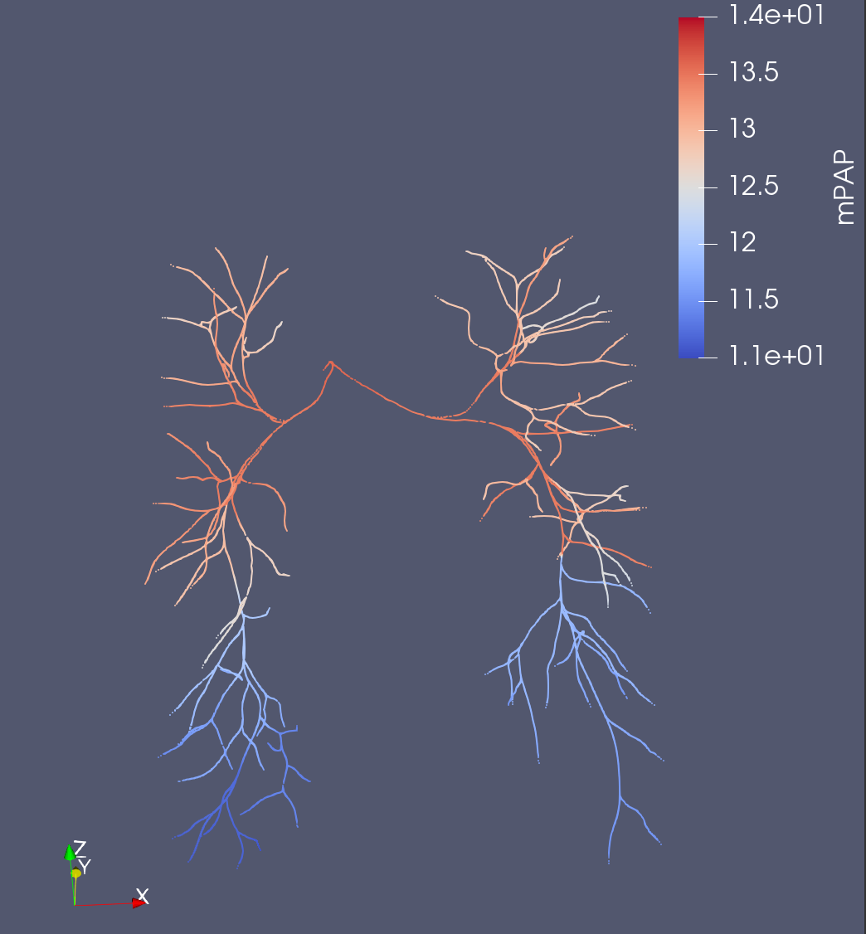
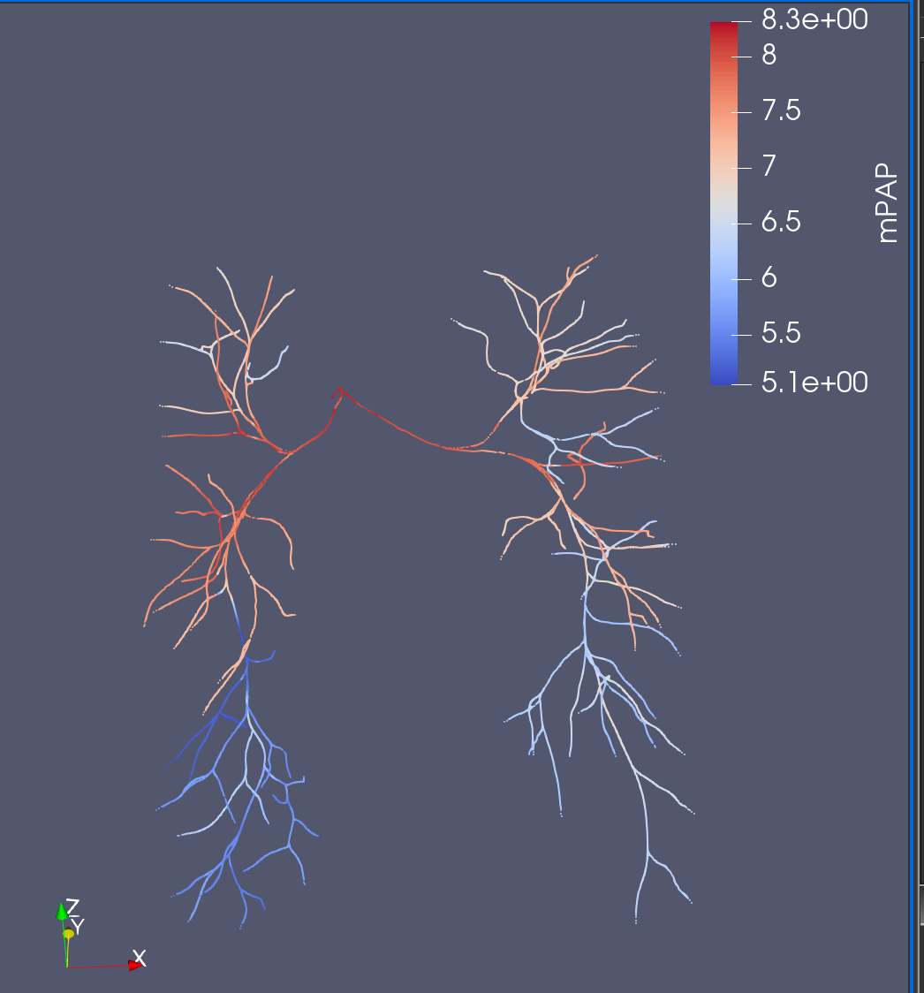
0D vs. 3D (mPAP)
Base Solver
Method 1 (stenosis coeff)
3D
Notes:
Larger pressure drop across tree w/ M1. Similar to the pressure drop in 3D.
However, the 3D model seems a bit off/low. mPAP should be around 12 – 16, at least in inlet. May need to run own 3D
Not to scale

Slide 14
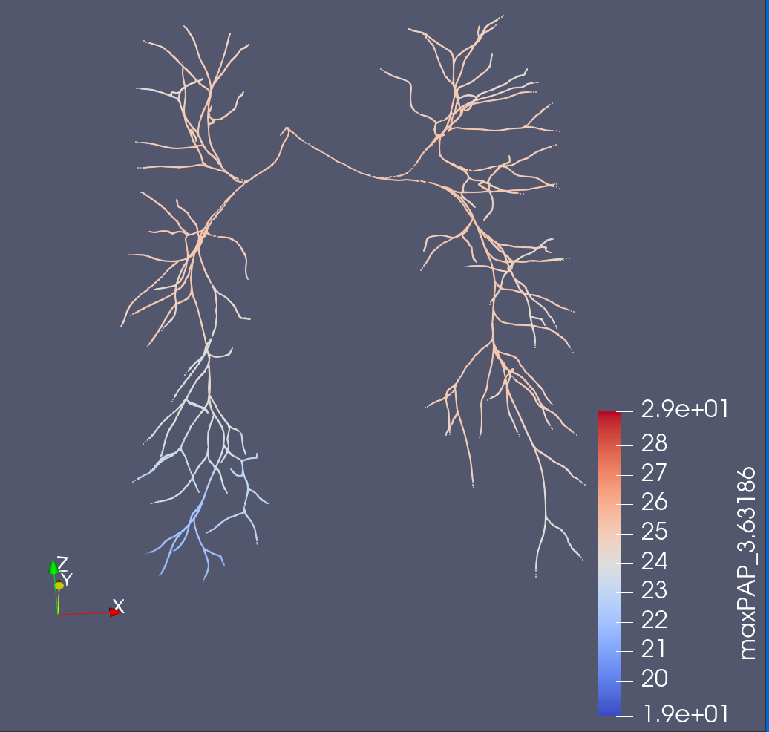
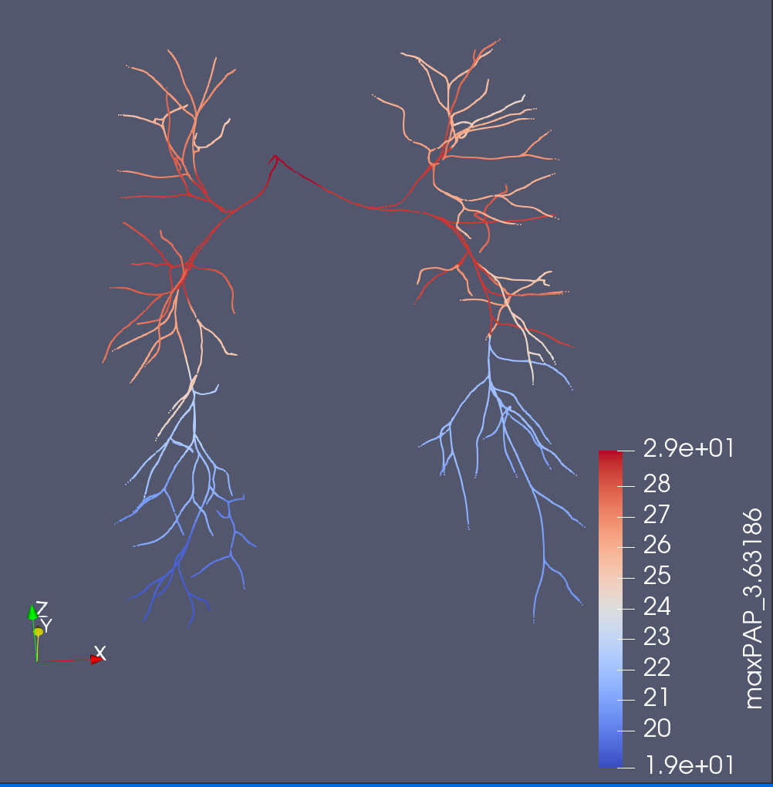
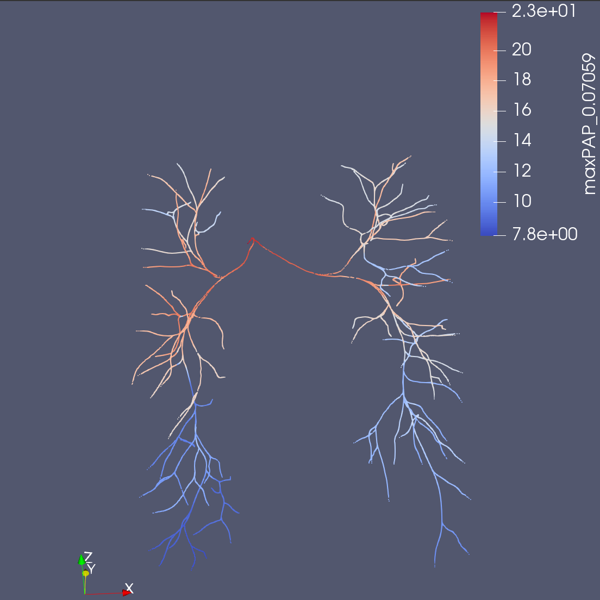
0D vs. 3D (maxPAP)
Base Solver
Method 1 (stenosis coeff)
3D
Notes:
Larger pressure drop across tree w/ M1. Less similar than mPAP, but still close.
3D model seems more reasonable here, with 23 mmHG down to 7.8.
Not to scale

Slide 15
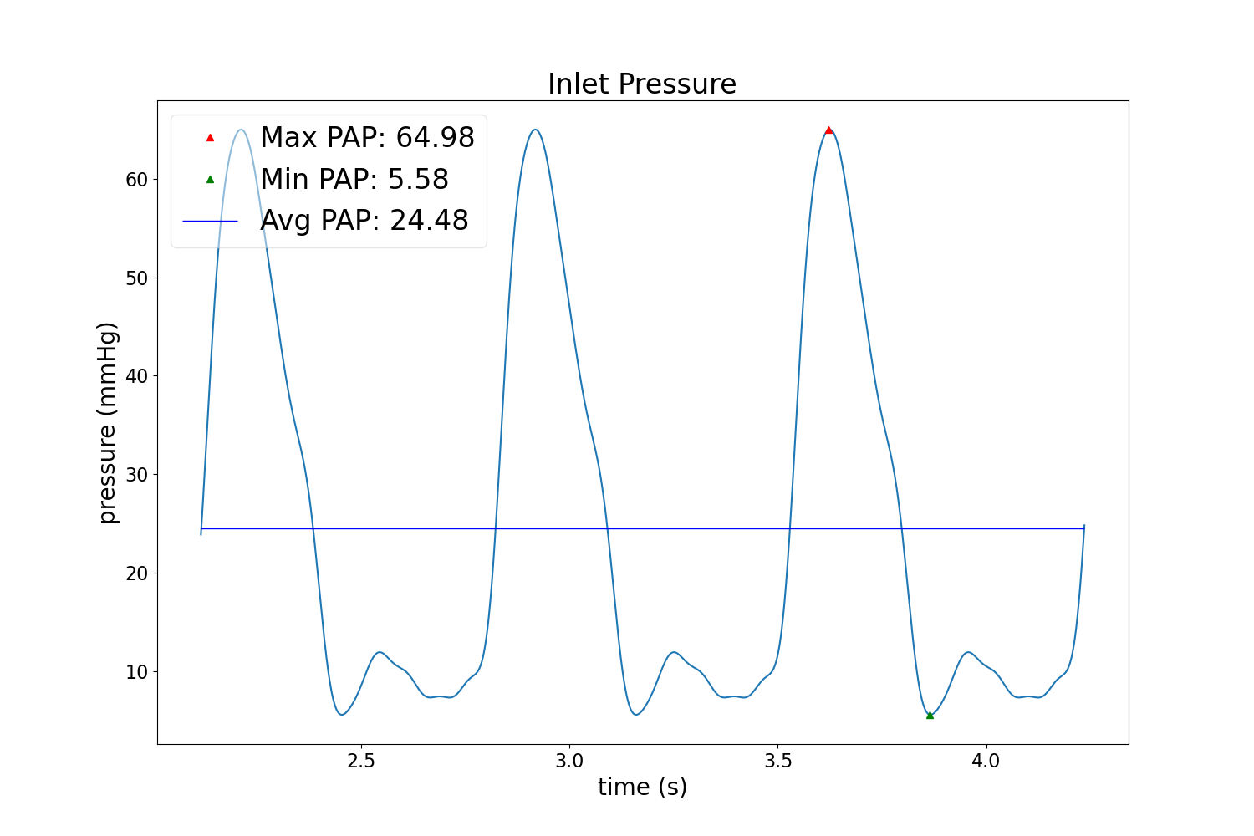
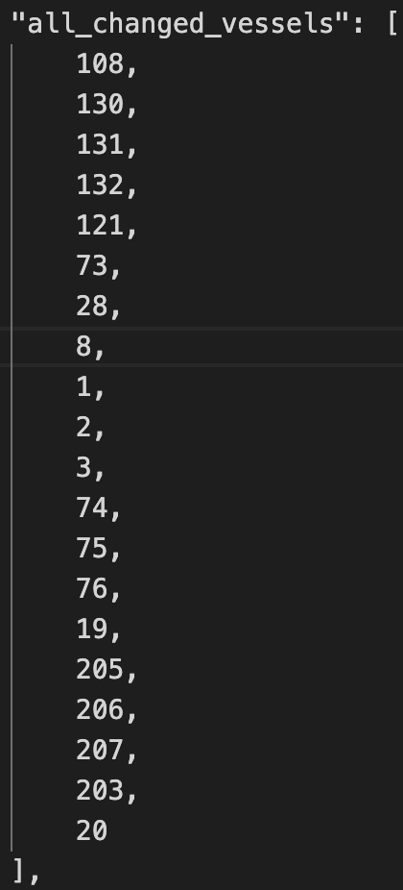
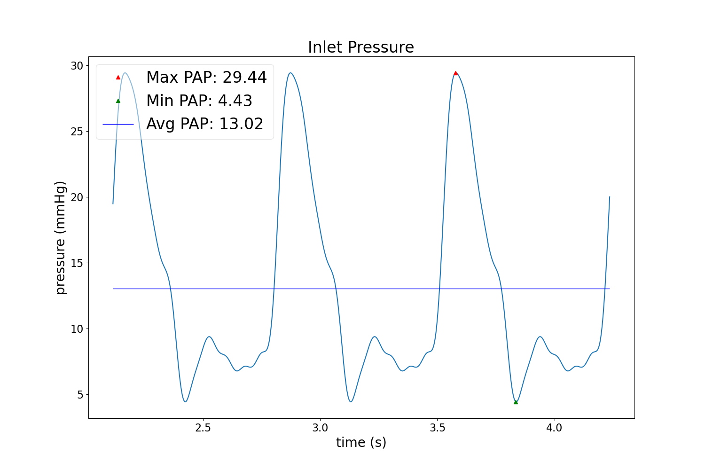
Waveforms
Base, No Changes
Random Stenosis (Left) (includes LPA)
Proximal Stenosis (MPA, LPA, RPA)
Notes:
Stenosis is rather extreme/common to obtain that pressure increase
Since Boundary conditions are tuned for healthy cases, they are not the most appropriate for the artificial stenosis
We can see that the min PAP is dropping
Do we need an Adaptive BC & how to do so
Rather odd that stenosing the Proximal vessels are not drastically increasing pressure.

Slide 16
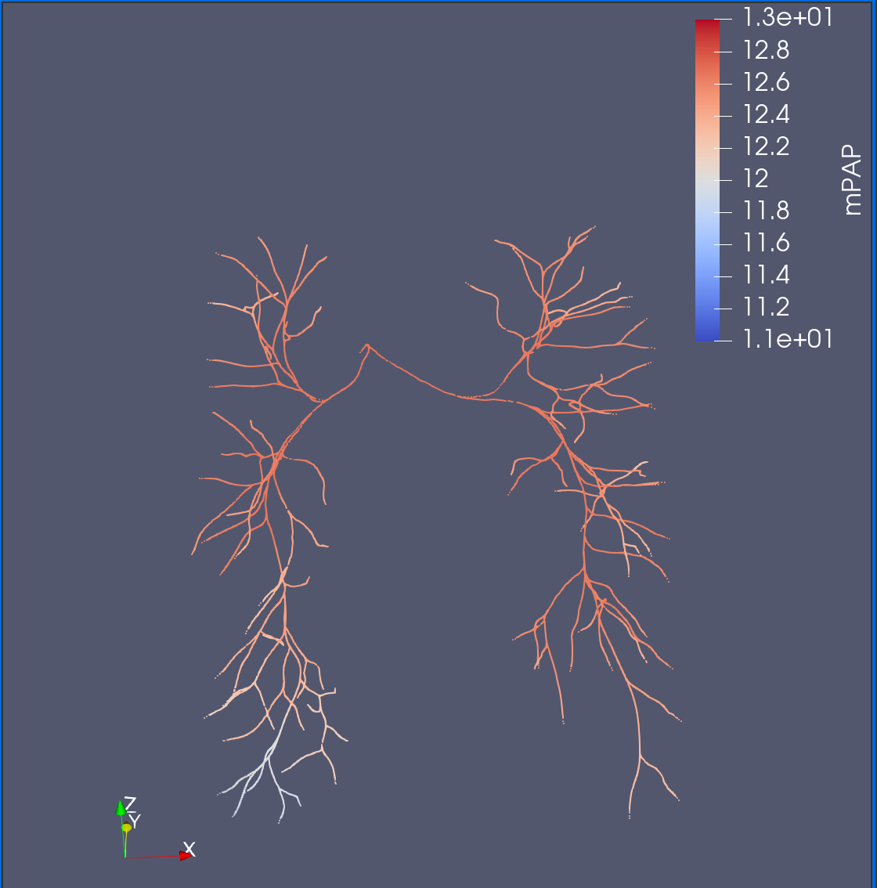
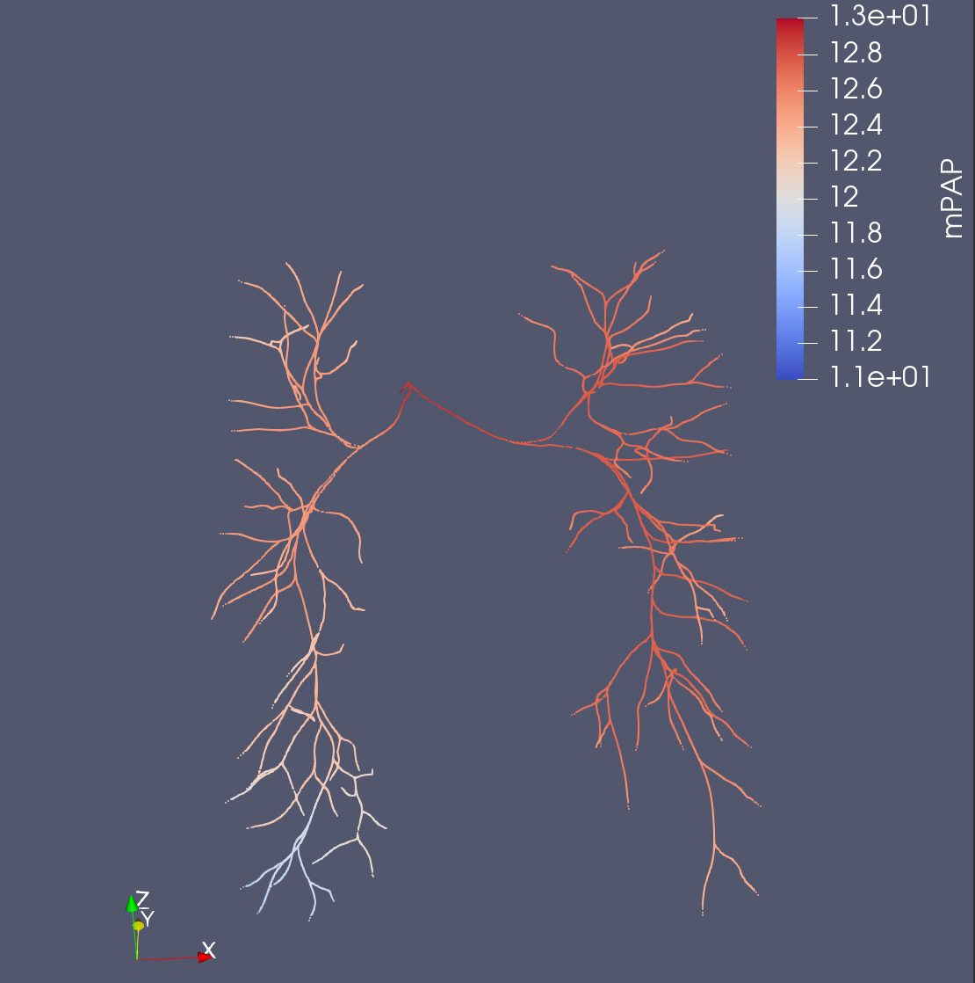
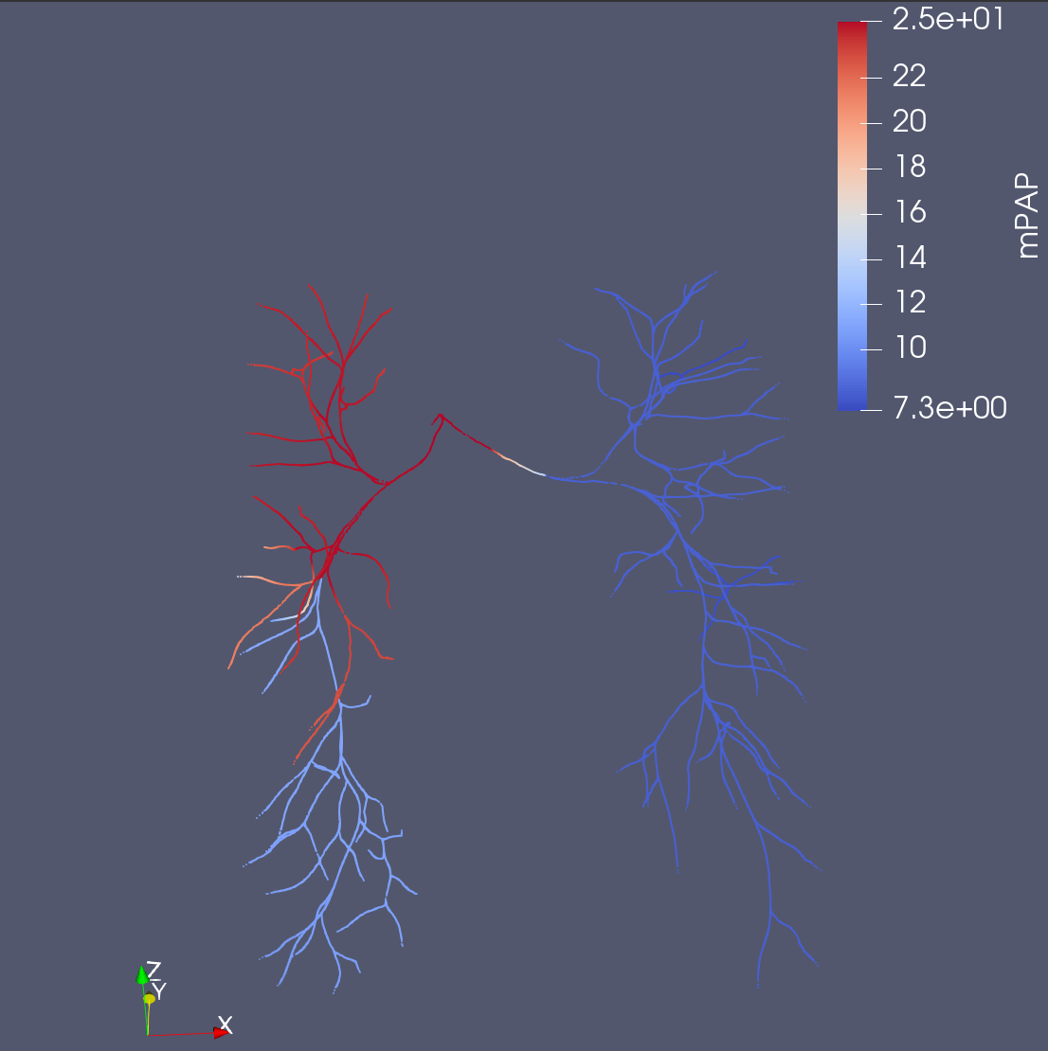
No Stenosis
Proximal Stenosis
Random Stenosis
Not same scale
Notes:
Hardly any pressure drop w/ None & Proximal
Significant Pressure Increase/Drop across tree with more stenosis Points.
Positive indication that stenosis is at least working, but must test with less occlusion @ less points
mPAP

Slide 17
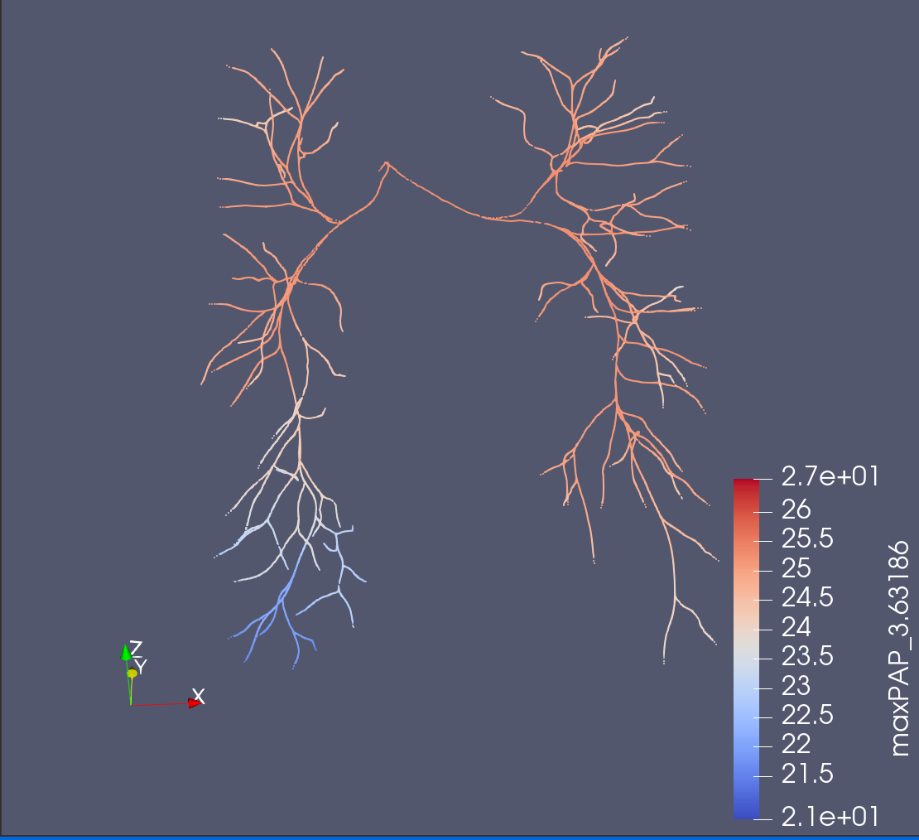
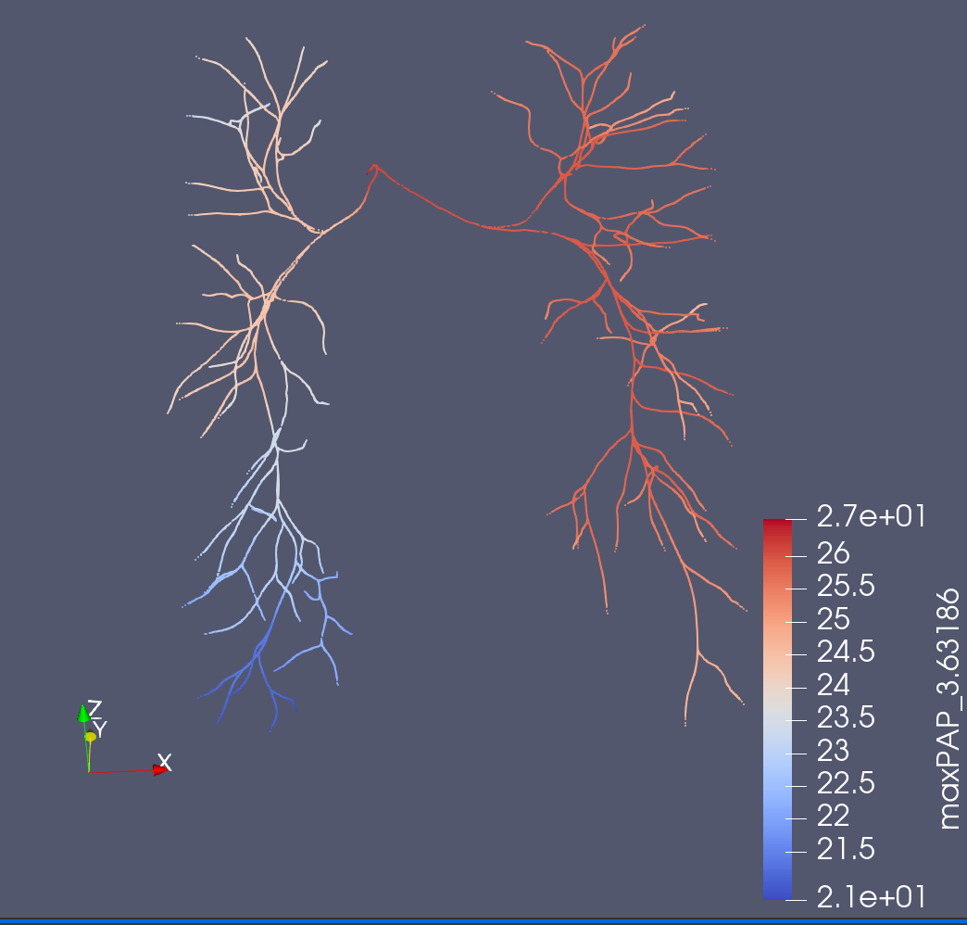
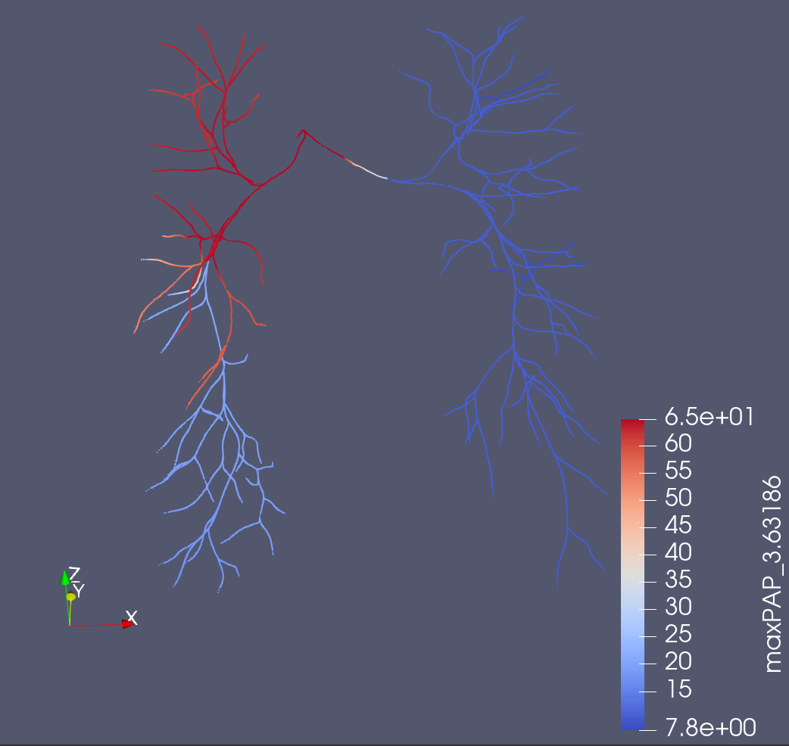
No Stenosis
Proximal Stenosis
Random Stenosis
Not same scale
Notes:
Very similar to mPAP
max PAP

Slide 18
Next Steps w/ Healthy
Check with less stenosis and occlusion
Maybe consider a different way to select stenosis points
Double check realism?
Run a 3D to compare
Run 3D of stenosis case (to look at in the future)

Slide 19
Stenosis Models – Stenosis Detection

Slide 20
Stenosis Models
Only use models where an RCRT.dat file is provided for 3D simulations
Must be mapped back to 0D style where face/cap names are also included in the file
Comes from both VMR & Ingrid’s previous models

Slide 21
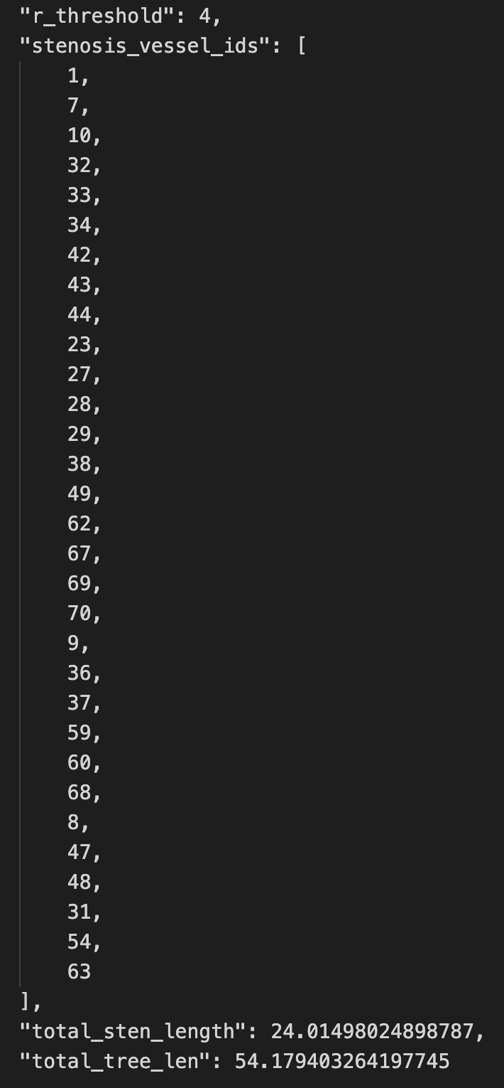
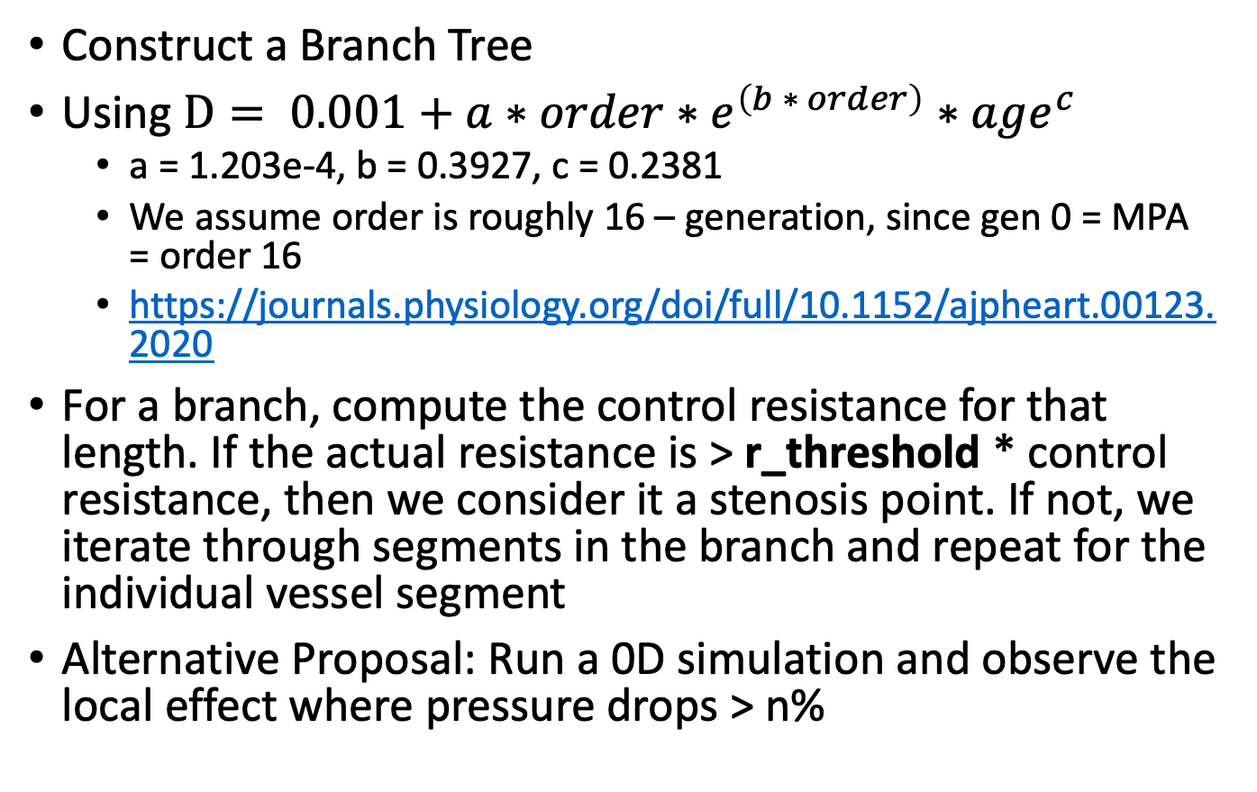
Identifying Stenosis Methodology
Construct a Branch Tree
Using $D= 0.001+a∗order∗e^{\left(b ∗ order\right)}∗age^{c}$
a = 1.203e-4, b = 0.3927, c = 0.2381
We assume order is roughly 16 – generation, since gen 0 = MPA = order 16
https://journals.physiology.org/doi/full/10.1152/ajpheart.00123.2020
For a branch, compute the control resistance for that length. If the actual resistance is > r_threshold * control resistance, then we consider it a stenosis point. If not, we iterate through segments in the branch and repeat for the individual vessel segment
Alternative Proposal: Run a 0D simulation and observe the local effect where pressure drops > n%

Slide 22
Stenosis Case Study Model - 0118_1000

Slide 23
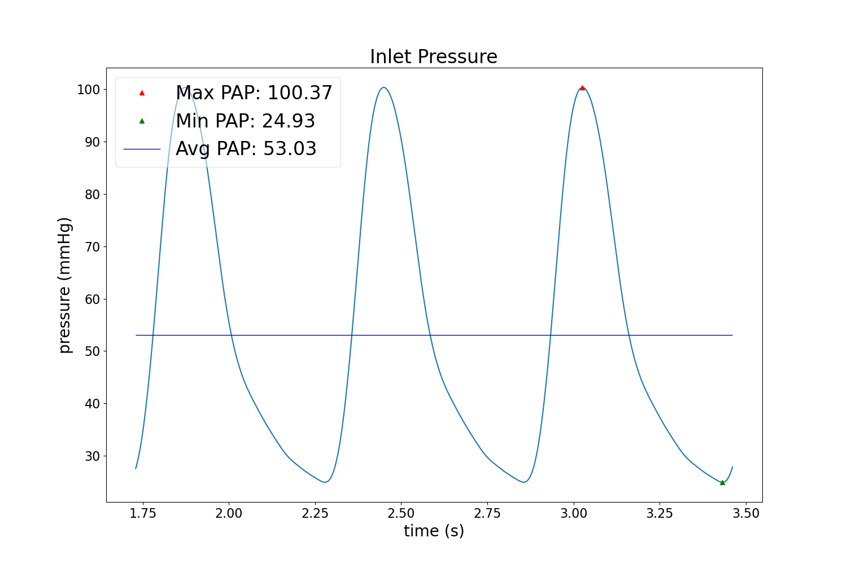
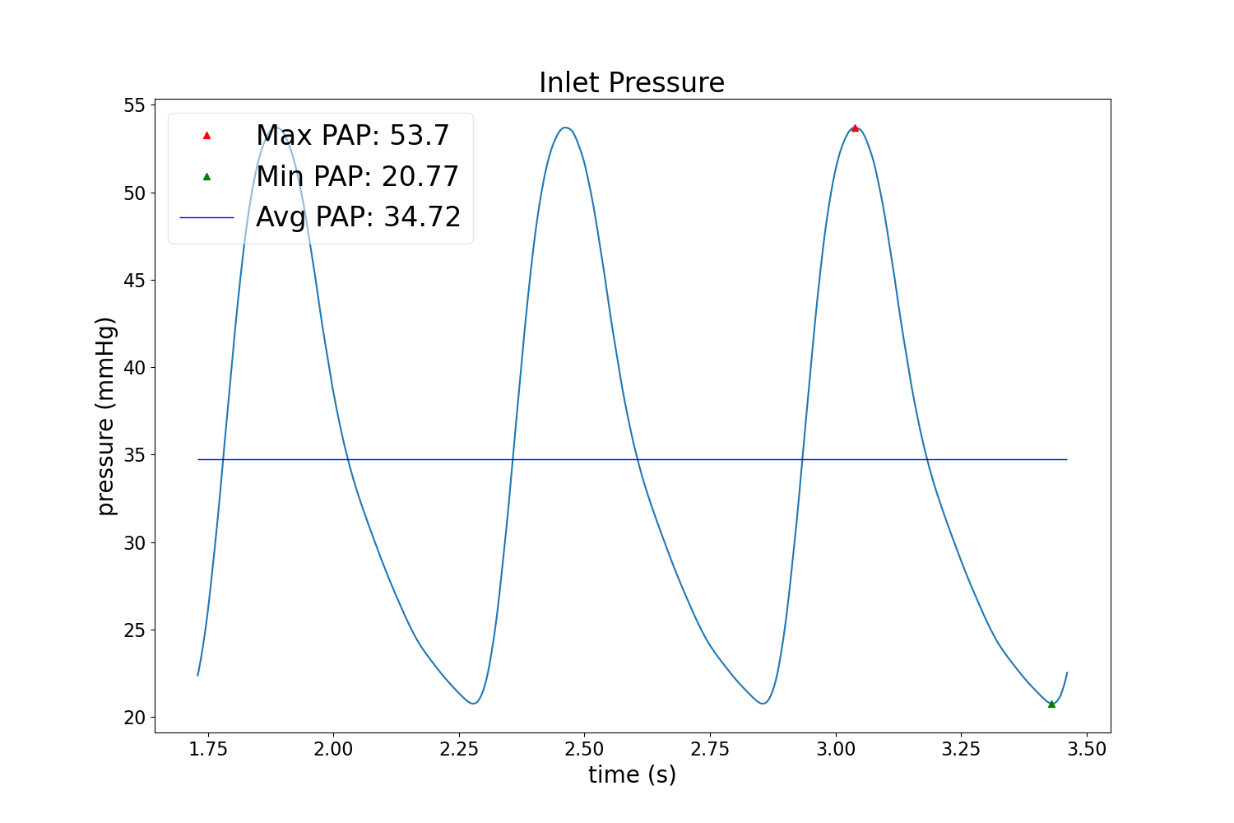
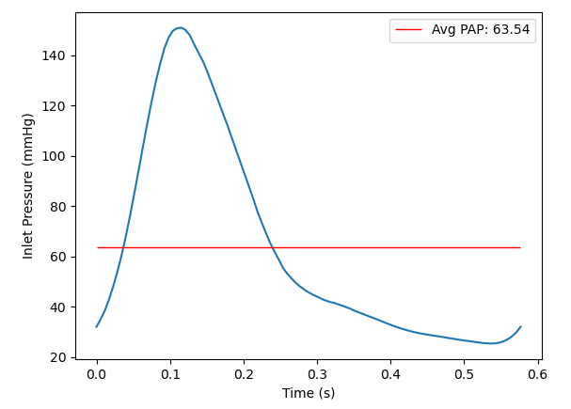
0D vs. 3D (Waveforms)
Base Solver
M1 Solver
Notes:
M1 seems to capture 3D better in general, but still a little low
Waveforms seem kind of odd, do they need retuning?
3D Solver

Slide 24
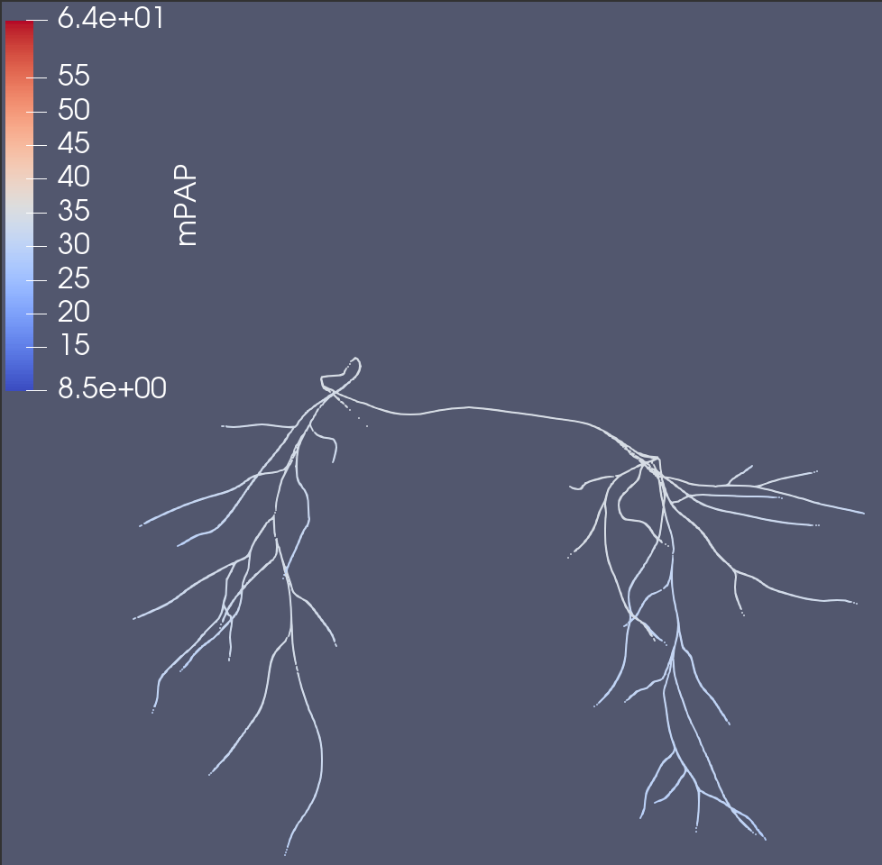
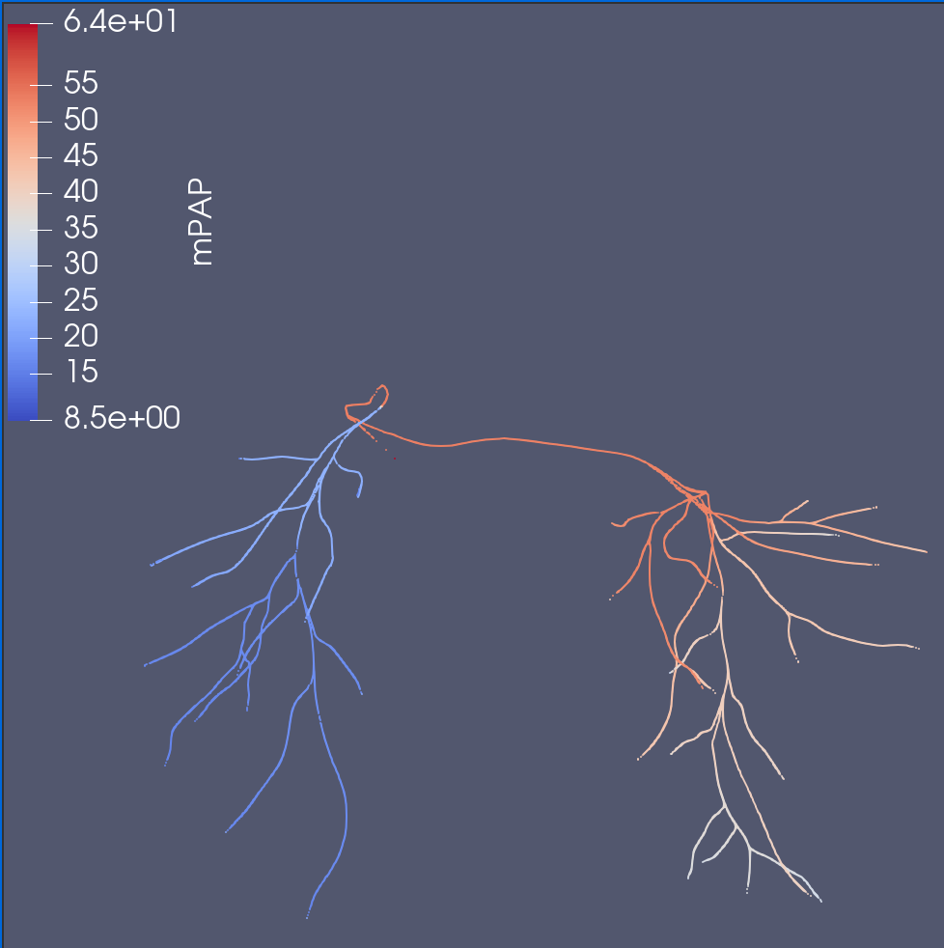
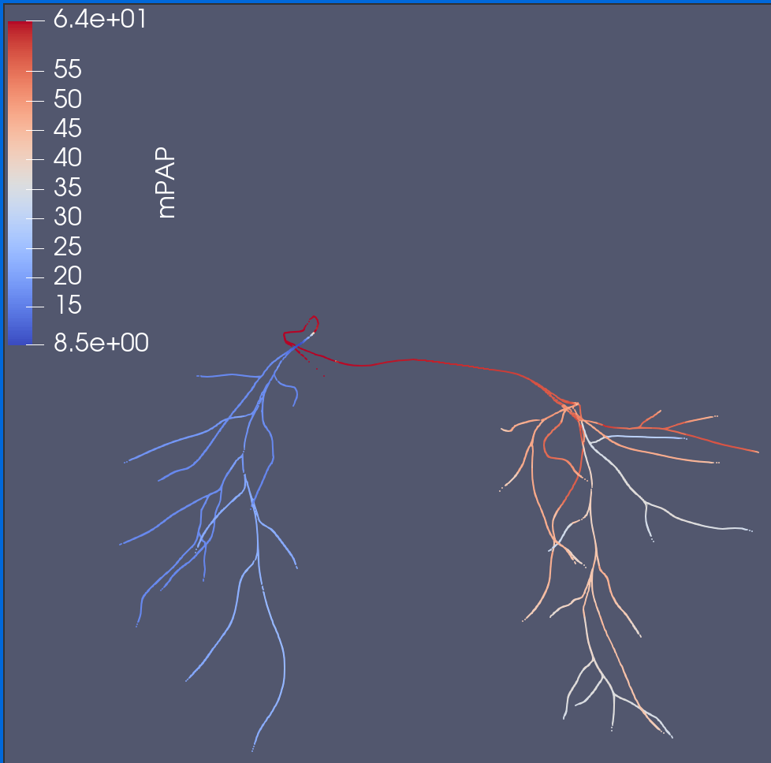
0D vs. 3D (mPAP)
Method 1 (stenosis coeff)
3D
Base Solver
Notes:
Larger pressure drop across tree w/ M1. Definitely capturing flow/pressures drops better
0D Solver Bc’s were taken exactly from 3D simulation, so the 3D should be an exact match

Slide 25
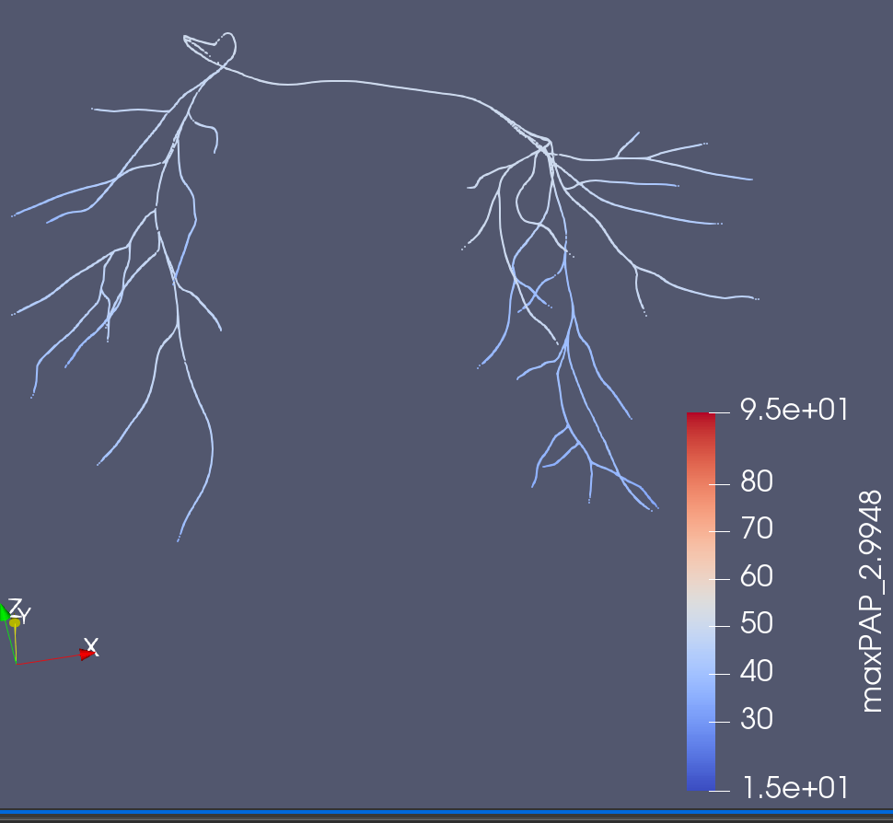
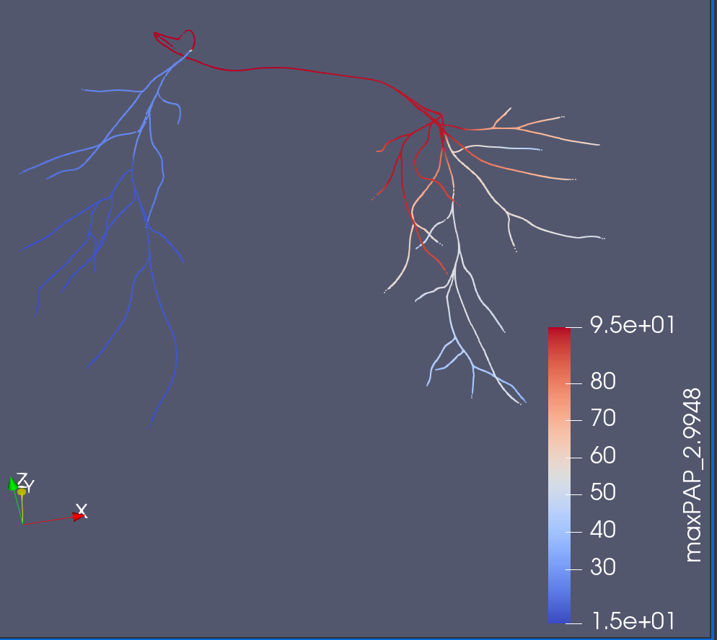
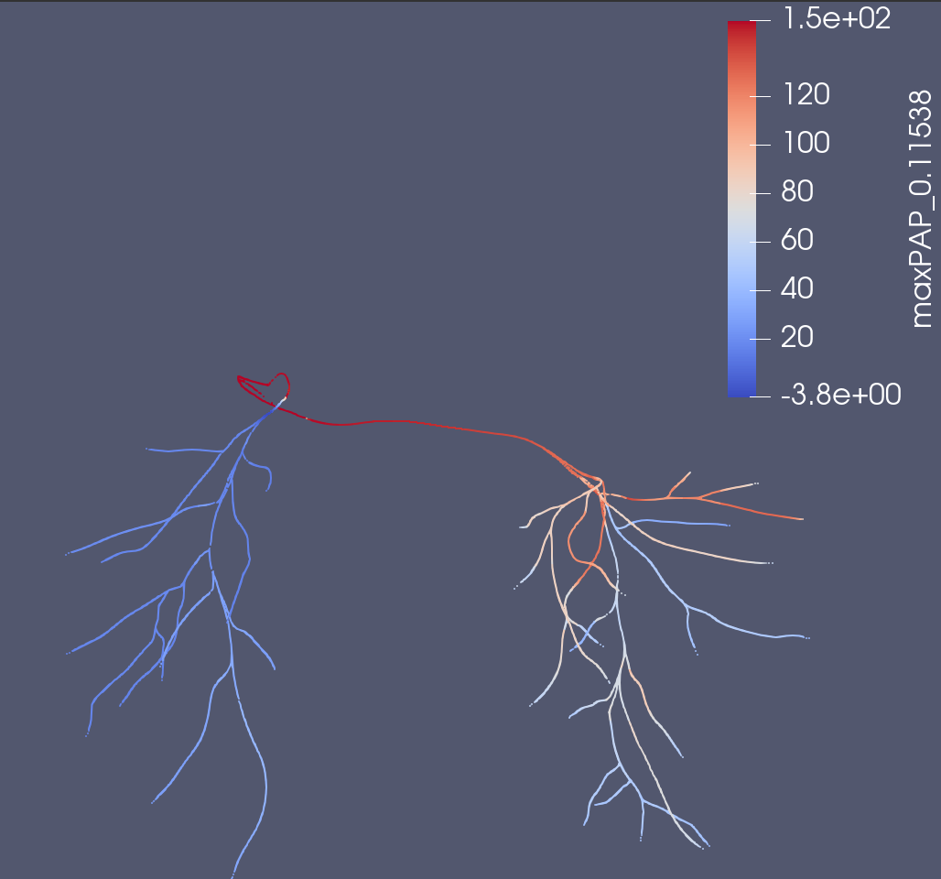
0D vs. 3D (maxPAP)
Base Solver
Method 1 (stenosis coeff)
3D
Notes:
There is definitely a larger pressure drop w/ M1
3D model has a negative pressure at choke point in RPA? Is this even valid
Ask in lab meeting
Not to scale

Slide 26
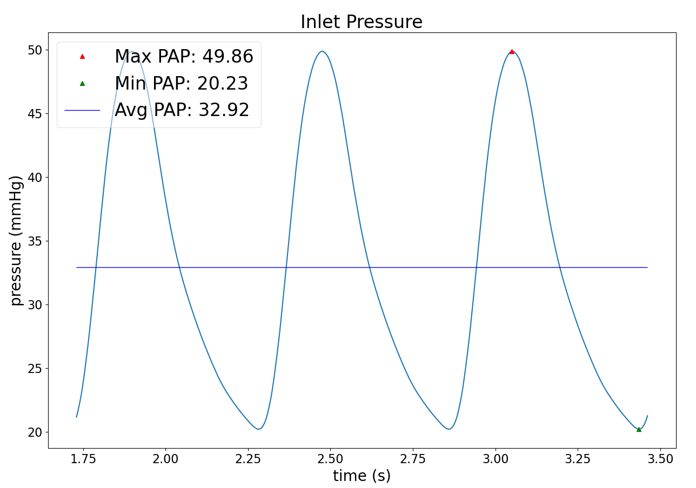
Original vs. Fixed (Waveforms)
Base Solver
Fixed Solver
Notes:
Only Minor Reductions, as expected since most of the stenosis was encountered in the junction

Slide 27
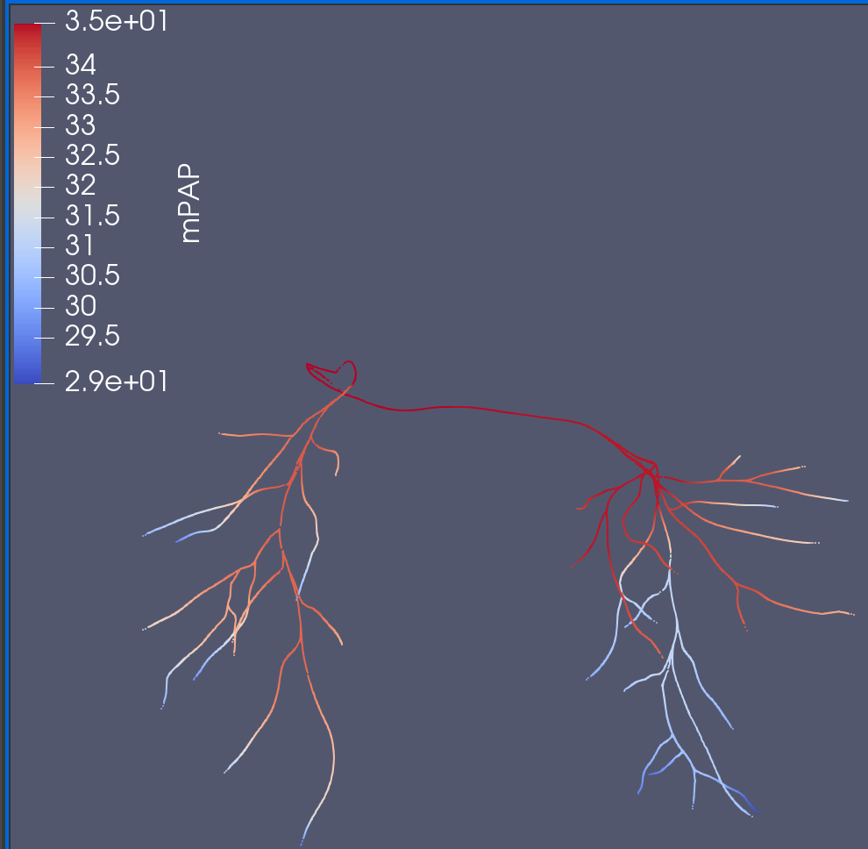
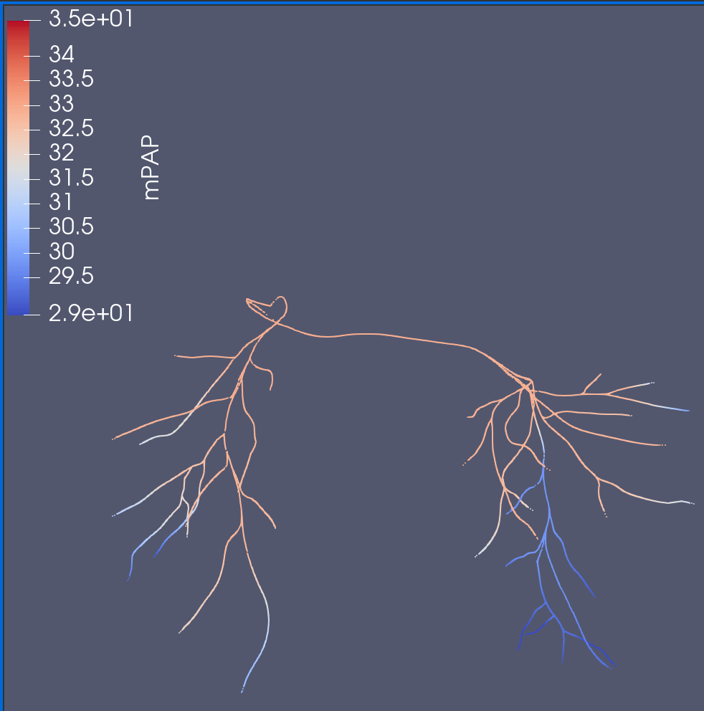
No Fix
Fixed Stenosis
Notes:
Minor decrease
mPAP

Slide 28
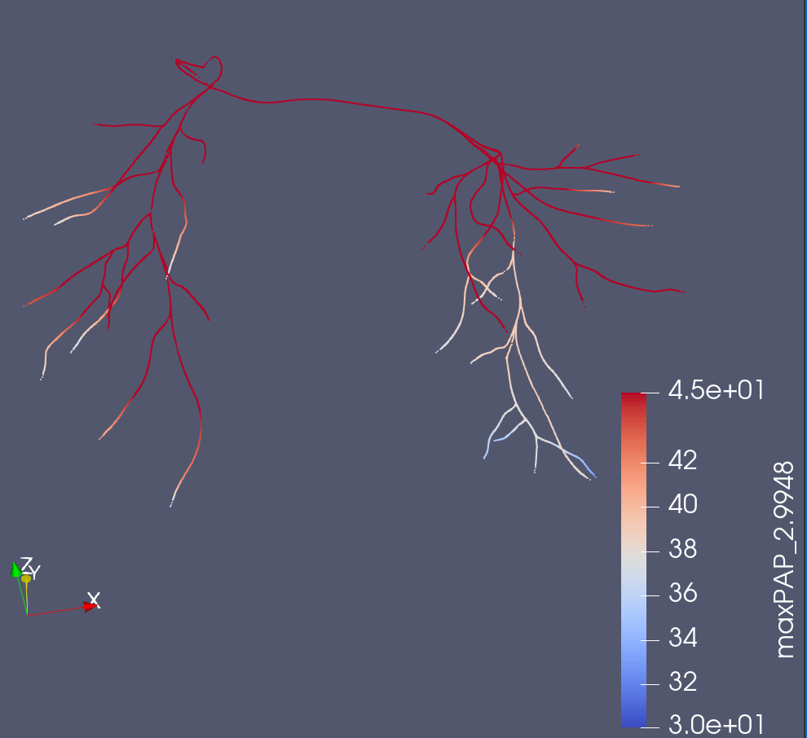
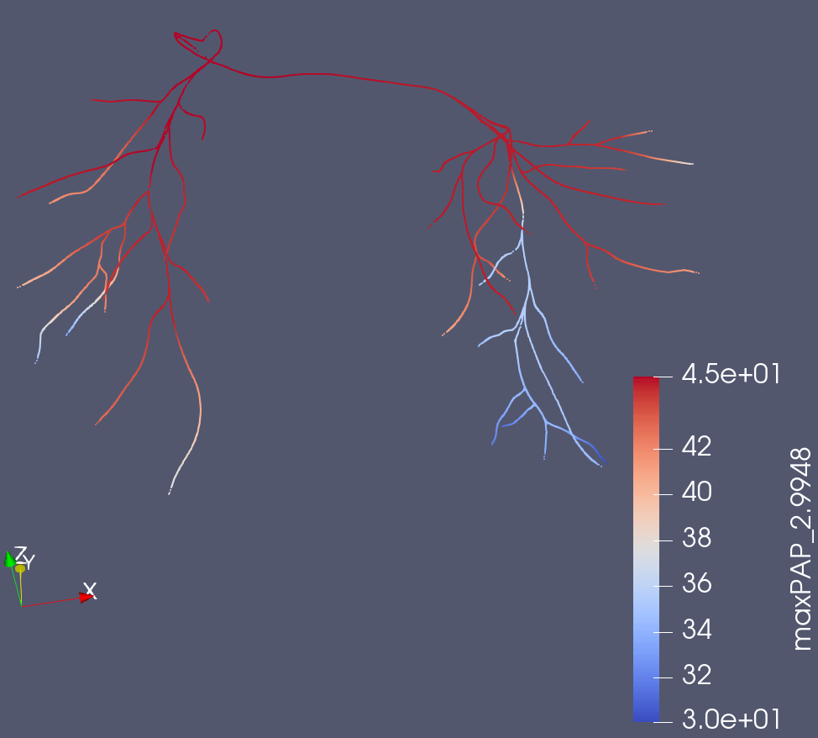
No Fix
Fixed Stenosis
Notes:
Minor decreases too, particularly at ends
maxPAP

Slide 29
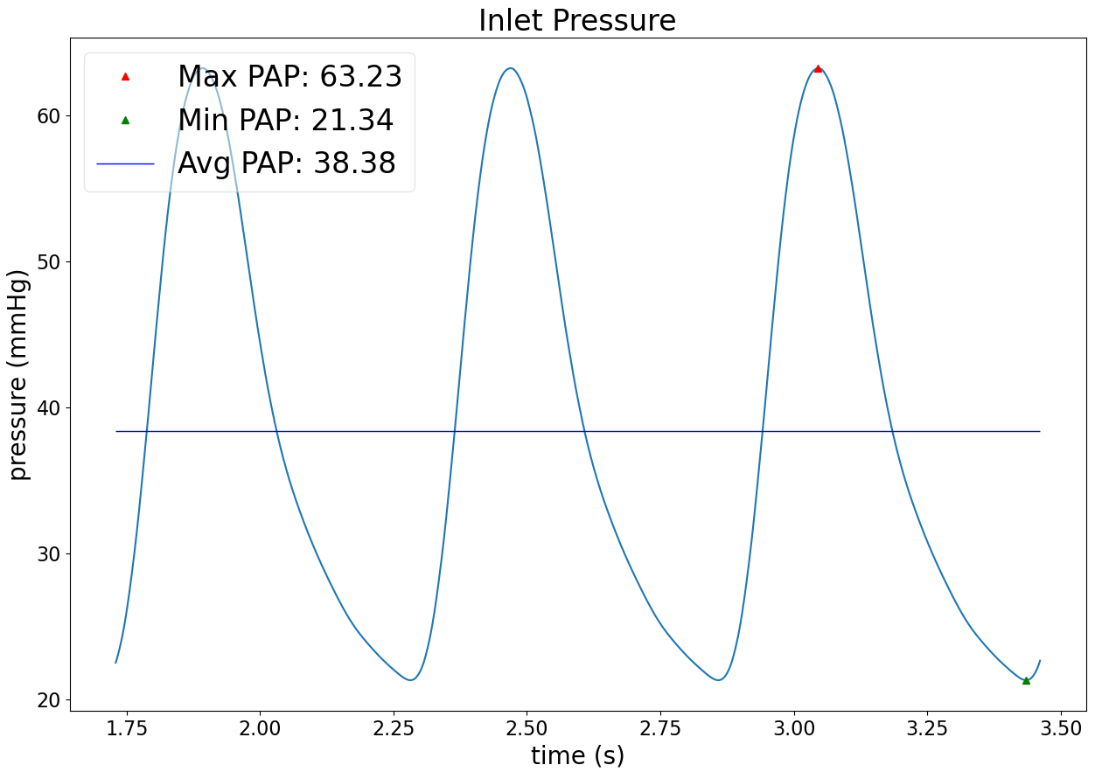
M1 vs. Fixed (Waveforms)
M1 Solver
M1 Fixed Solver
Notes:
There is a significant reduction in all parameters, indicating positive viability for this approach.
Also, there is actually no change in the vessels that were determined to be
***The fixing operation is slightly off, since it reduces the lumped stenosis coefficient in downstream branch vessels, only by the increase in the vessel’s radii, not considering the junction radii

Slide 30
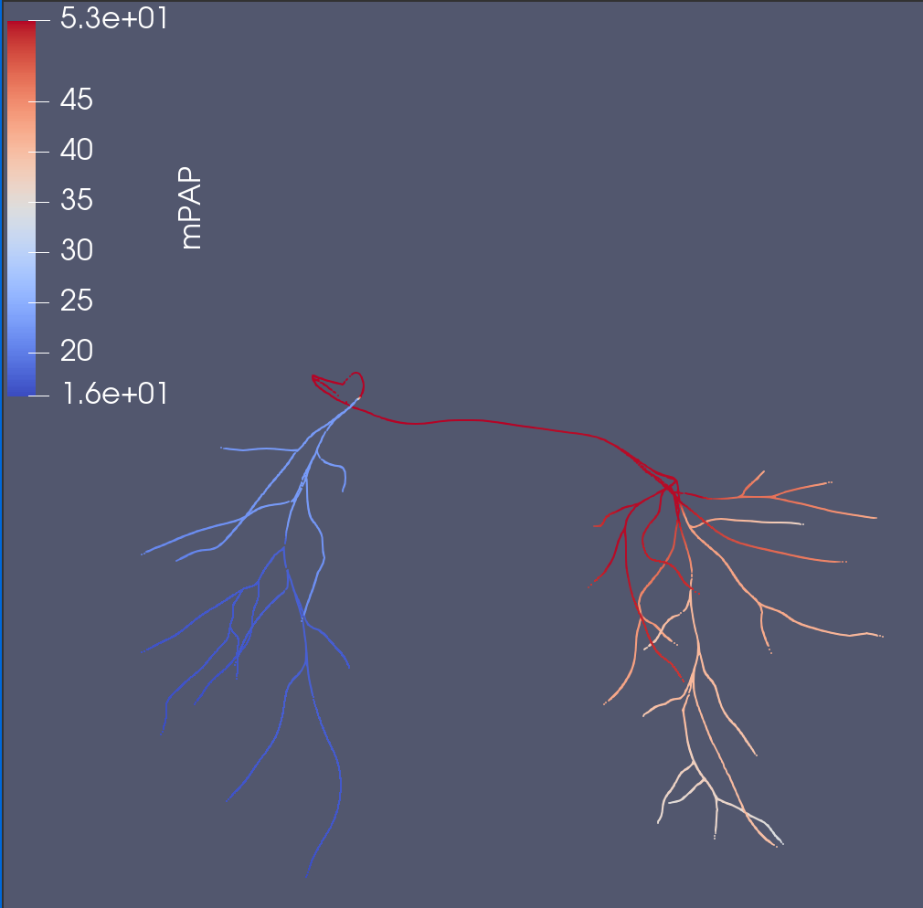
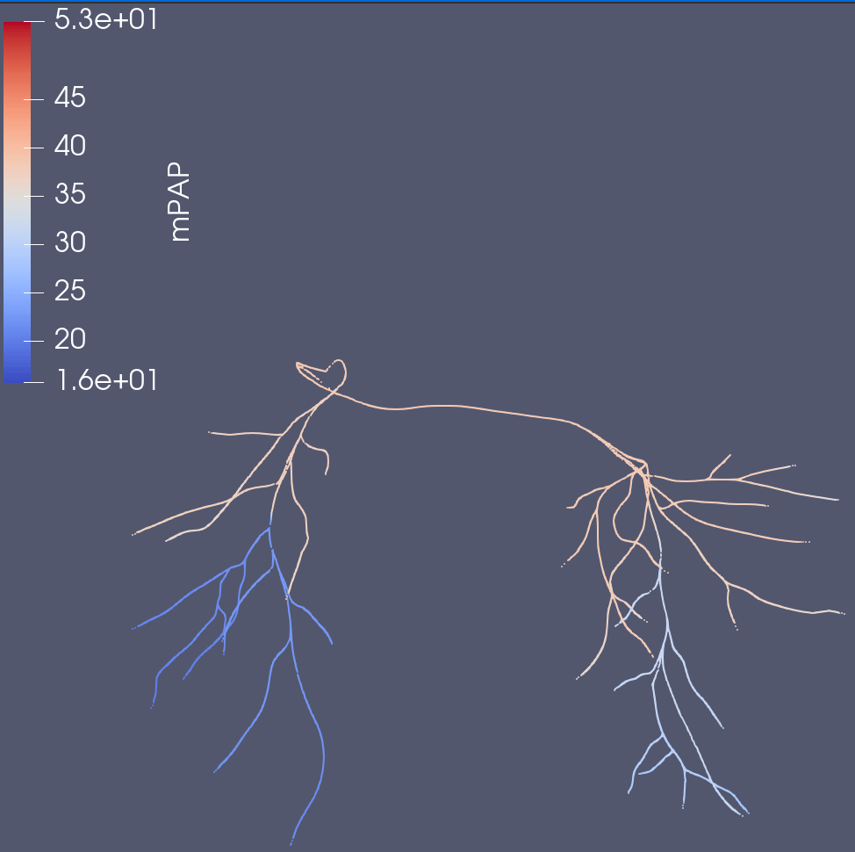
No Fix M1
Fixed M1 Stenosis
Notes:
Clear decrease in pressure, but also a more even pressure drop between LPA and RPA
mPAP

Slide 31

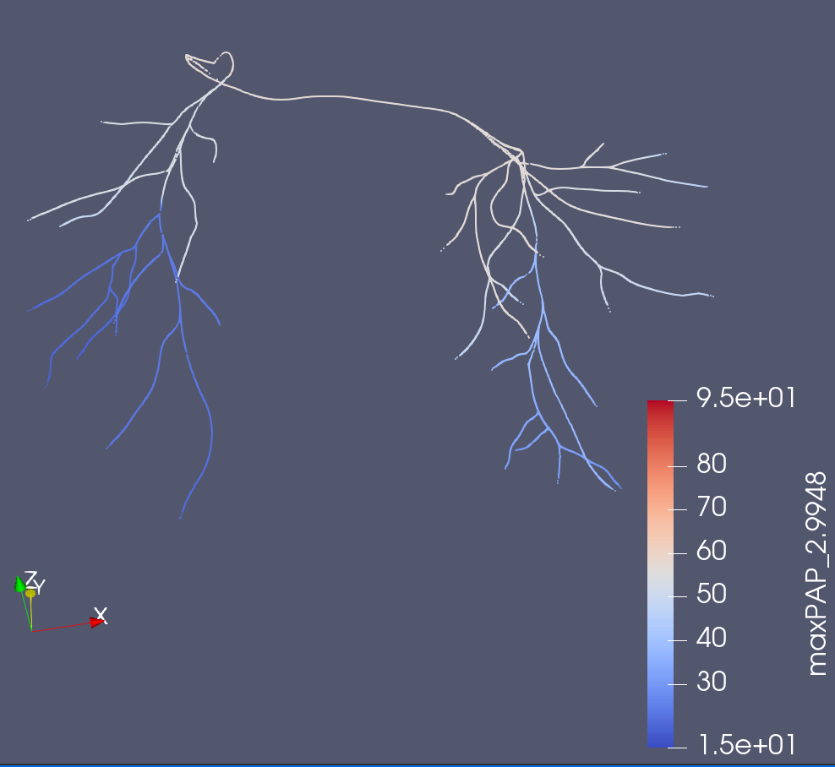
No Fix M1
M1 Fixed Stenosis
Notes:
Very large drop, with more even pressures.
maxPAP

Slide 32
Stenosis Case Study Model – SU0238

Slide 33
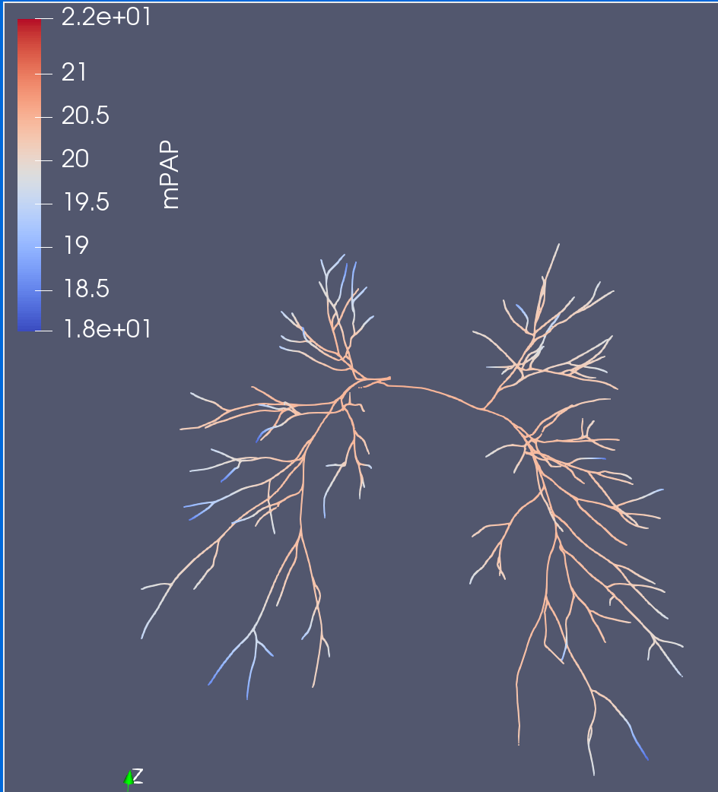


0D vs. 3D (mPAP)
3D
Method 1 (stenosis coeff)
Base Solver
Notes:
Branch 93, Vessel 143, *Are some places with negative flow, but the pressure drop on average for that vessel is still positive (Is there an interpolation error???) The recorded outlet pressures are all around 20, which is not a huge drop?
Vessel by vessel, the min pressure out is around 17, (and the average pout is 19-20) which is to be expected. Hence I suggest some issue with interpolation.
Regardless, M1 is NOT capturing the 3D solution’s pressure drop.
Not to scale

Slide 34
Other Potential Solutions

Slide 35
Method 1 (being implemented)
Computing a stenosis coefficient only using input radii and output radii of a junction. Adding stenosis coefficient to downstream vessel.
Problems:
May not be a good representation. Could drastically increase stenosis coefficient if input radii is really small. (Does not seem to be a huge problem as of right now)
When performing stenosis fixture, it is not as easy to factor in stenosis coefficient reduction of vessel separately from the junction (doable though)
May have errors mapping back into centerlines (possible issue)
Does not work sufficiently with SU0238 (could be due to a different issue though)
Success
Better representation with 0118_0001
Only slightly elevating 0080_1000, which is good.

Slide 36
Method 2
More intensive representation of branches, rather than just stenosis coefficient to downstream vessels
Problems
May require much more involved changes to input file construction and mapping back to centerlines (not too familiar with code/no access)
Perhaps already being planned to be implemented (Martin would know)
Challenging to handle, since we can’t use Poiseuille laws easily

Slide 37
Method 3 (Could go back and do later)
Given the nature of my task, we can run a 3D simulation “offline” first, then construct a more accurate representation of the 0D model using actual pressure drops across branches/segments
Could save at less number of timesteps to allow for faster computation of 3D solver, at cost of slightly less accurate optimization
Basically optimize the RCL for each branch such that an appropriate pressure drop/flow decrease is reached.
Problems:
Very time intensive/code involved. May require more familiarity with vtk
Concerns that 0D will not continue to match 3D if stenosis is introduced.
How to segment the vasculature
Pros
High likely to work/be accurate

Slide 38
Suggestion for Next Steps
Tinker w/ Healthy models a bit more (We can guarantee that stenosis of healthy models will solely be in the vessels, hence not encountering the junction stenosis issue)
Generate more models/case studies for healthy models.
(~1 week, assuming no major issues)
Construct Neural network for 0D simulations on healthy models.
(~1 week)
Compute Probabilities/Build tool
(Back at ND)
*Uncertainty computation?
(Back at ND)
*Go back and implement Method 3.

Slide 39
Next Steps (Neural Network)
Construct NN capturing the changes in pressures and flows depending on the change in resistance
Sample from resistance space using Sobol Sampling
Compute Probabilities

Slide 40





Flows V143
Pressures V143

